Slide 1

Data Mining
CS-772
Department of Computer Sciences

Slide 2
Classification
Nearest Neighbour

Slide 3
K-NN
The idea is to estimate the classification of an unseen instance using the classification of the instance or instances that are closest to it, in some sense that we need to define.
Nearest Neighbour classification is mainly used when all attribute values are continuous, although it can be modified to deal with categorical attributes.

Slide 4
Example
Supposing we have a training set with just two instances such as the following
a b c d e f Class
yes no no 6.4 8.3 low negative
yes yes yes 18.2 4.7 high positive
There are six attribute values, followed by a classification (positive or negative).
We are then given a third instance
yes no no 6.6 8.0 low ???
What should its classification be?
Negative
Notes:
Even without knowing what the six attributes represent, it seems intuitively
obvious that the unseen instance is nearer to the first instance than to the
second. In the absence of any other information, we could reasonably predict
its classification using that of the first instance, i.e. as ‘negative’.

Slide 5
Basic k-Nearest Neighbor Classification Algorithm
In practice there are likely to be many more instances in the training set but the same principle applies.
It is usual to base the classification on those of the k nearest neighbours (where k is a small integer such as 3 or 5), not just the nearest one.
The method is then known as k-Nearest Neighbour or just k-NN classification
– Find the k training instances that are closest to the unseen instance.
– Take the most commonly occurring classification for these k instances.

Slide 6
Dimensions
Attrib 1 Attrib 2 Class
0.8 6.3 −
1.4 8.1 −
2.1 7.4 −
2.6 14.3 +
6.8 12.6 −
8.8 9.8 +
9.2 11.6 −
10.8 9.6 +
11.8 9.9 +
12.4 6.5 +
12.8 1.1 −
14.0 19.9 −
14.2 18.5 −
15.6 17.4 −
15.8 12.2 −
16.6 6.7 +
17.4 4.5 +
18.2 6.9 +
19.0 3.4 −
19.6 11.1 +
k-NN classification can be illustrated diagrammatically when the dimension (i.e. the number of attributes) is small.
In real-world data mining applications the number of attributes can of course be considerably larger.
The example illustrates the case where the dimension is just 2.

Slide 7
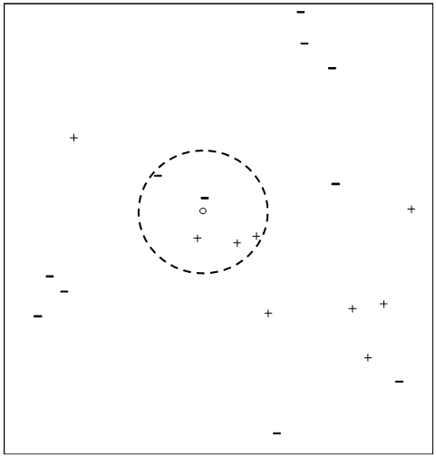
Example
‘Unseen’ instance where the first and second attributes are 9.1 and 11.0, respectively?
For this small number of attributes we can represent the training set as 20 points on a two-dimensional graph with values of the first and second attributes measured along the horizontal and vertical axes, respectively.
Each point is labelled with a + or − symbol to indicate that the classification is positive or negative, respectively.
A circle has been added to enclose the five nearest neighbours of the unseen
instance, which is shown as a small circle close to the centre of the larger one.

Slide 8
5-NN
The five nearest neighbours are labelled with three + signs and two − signs, so a basic 5-NN classifier would classify the unseen instance as ‘positive’ by a form of majority voting.
There are other possibilities, for example the ‘votes’ of each of the k nearest neighbours can be weighted, so that the classifications of closer neighbours are given greater weight than the classifications of more distant ones.

Slide 9
Dimensions Representation
We can represent two points in two dimensions (‘in two-dimensional space’ is the usual term) as (a₁, a₂) and (b₁, b₂) and visualise them as points in a plane.
When there are three attributes we can represent the points by (a₁, a₂, a₃) and (b₁, b₂, b₃) and think of them as points in a room with three axes at right angles.
As the number of dimensions (attributes) increases it rapidly becomes impossible to visualise them.
When there are n attributes, we can represent the instances by the points (a₁, a₂, . . . , a_{n}) and (b₁, b₂, . . . , b_{n}) in ‘n-dimensional space’

Slide 10
Distance Measures
There are many possible ways of measuring the distance between two instances with n attribute values, or equivalently between two points in n-dimensional space.
We usually impose three requirements on any distance measure we use.
We will use the notation dist(X, Y ) to denote the distance between two points X and Y .
1. The distance of any point A from itself is zero, i.e. dist(A,A) = 0.
2. The distance from A to B is the same as the distance from B to A,
i.e. dist(A,B) = dist(B,A) (the symmetry condition).
3. The third condition is called the triangle inequality .
It corresponds to the intuitive idea that ‘the shortest distance between any two points is a straight line’.
The condition says that for any points A, B and Z:
dist(A,B) ≤ dist(A,Z) + dist(Z,B).
The equality only occurs if Z is the same point as A or B or is on the direct route between them.

Slide 11
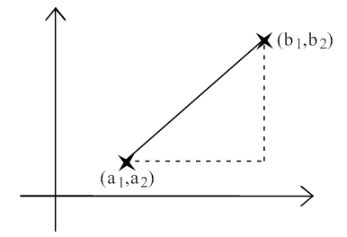
Euclidean Distance
There are many possible distance measures, but the most popular is almost certainly the Euclidean Distance
Illustrating the formula for Euclidean distance in two dimensions.
If we denote an instance in the training set by (a₁, a₂) and the unseen instance by (b₁, b₂) the length of the straight line joining the points is
√(a₁ − b₁)² + (a₂ − b₂)²
by Pythagoras’ Theorem.

Slide 12
N-Dimensions
If there are two points (a1, a2, a3) and (b1, b2, b3) in a three-dimensional space the corresponding formula is
√(a₁ − b₁)² + (a₂ − b₂)² + (a₃ − b₃)²
The formula for Euclidean distance between points (a₁, a₂, . . . , a_{n}) and (b₁, b₂, . . . , b_{n}) in n-dimensional space is a generalisation of these two results.
The Euclidean distance is given by the formula
√(a₁ − b₁)² + (a₂ − b₂)² + ... + (a_{n} − b_{n})²

Slide 13
Problem!
A major problem when using the Euclidean distance formula (and many other distance measures) is that the large values frequently swamp the small ones.
Suppose that two instances are as follows for some classification problem associated with cars (the classifications themselves are omitted).
Mileage (miles) Number of doors Age (years) Number of owners
18,457 2 12 8
26,292 4 3 1
When the distance of these instances from an unseen one is calculated, the mileage attribute will almost certainly contribute a value of several thousands squared, i.e. several millions, to the sum of squares total.
The number of doors will probably contribute a value less than 10.
Notes:
It is clear that in practice the only attribute that will matter when deciding which neighbours are the nearest
using the Euclidean distance formula is the mileage. This is unreasonable!

Slide 14
Normalization
To overcome this problem we generally normalise the values of continuous attributes.
The idea is to make the values of each attribute run from 0 to 1.
Suppose that for some attribute A the smallest value found in the training data is −8.1 and the largest is 94.3.
First we adjust each value of A by adding 8.1 to it, so the values now run from 0 to 94.3+8.1 = 102.4.
The spread of values from highest to lowest is now 102.4 units, so we divide all values by that number to make the spread of values from 0 to 1.
In general if the lowest value of attribute A is min and the highest value is max, we convert each value of A, say a, to (a − min)/(max − min).
Using this approach all continuous attributes are converted to small numbers from 0 to 1, so the effect of the choice of unit of measurement on the outcome is greatly reduced.
It is possible that an unseen instance may have a value of A that is less than min or greater than max.
If we want to keep the adjusted numbers in the range from 0 to 1 we can just convert any values of A that are less than min or greater than max to 0 or 1, respectively.

Slide 15
Weighing Dimension Contribution
We may believe that the mileage of a car is more important than the number of doors it has (although no doubt not a thousand times more important, as with the unnormalised values).
We extend measuring the distance between two points with the weighting of the contributions of the different attributes.
To achieve this we can adjust the formula for Euclidean distance to
√ w₁(a₁ − b₁)² + w₂(a₂ − b₂)² + ... + w_{n}(a_{n} − b_{n})²
where w₁, w₂, . . . , w_{n} are the weights.
It is customary to scale the weight values so that the sum of all the weights is one.

Slide 16
Determine good value for k!
“How can I determine a good value for k, the number of neighbors?”
This can be determined experimentally.
Starting with k D 1, we use a test set to estimate the error rate of the classifier.
This process can be repeated each time by incrementing k to allow for one more neighbor.
The k value that gives the minimum error rate may be selected.
In general, the larger the number of training tuples, the larger the value of k will be.
So, that classification and numeric prediction decisions can be based on a larger portion of the stored tuples

Slide 17
Speeding Up Classification
Speeding up classification time include the use of partial distance calculations and editing the stored tuples.
In the partial distance method, we compute
the distance based on a subset of the n attributes.
If this distance exceeds a threshold, then further computation for the given stored tuple is halted, and the process moves on to the next stored tuple.
The editing method removes training tuples that prove useless.
This method is also referred to as pruning or condensing because it reduces the total number of tuples stored.

Slide 18
Eager and Lazy Learners
In eager learning systems the training data is ‘eagerly’ generalised into some representation or model such as a table of probabilities, a decision tree or a neural net without waiting for a new (unseen) instance to be presented for classification.
In lazy learning systems the training data is ‘lazily’ left unchanged until an unseen instance is presented for classification. When it is, only those calculations that are necessary to classify that single instance are performed.
The Naïve Bayes and Nearest Neighbour algorithms described illustrate two alternative approaches to automatic classification, of eager learning and lazy learning, respectively.

Slide 19

Assignment
Group of two
Write a case study paper regarding solving a Classification Problem using K-NN.
Write the program for K-NN in any Programming Language
For which real data is available

